Slide 1






Meet the team :
Shreya
Yuyang (Sam)
Fengrong
Saumay
Sejal

Slide 2



Table of contents
1.Introduction
2.Existing Marketing Strategy
3. Major Competitors
4.SWOT Analysis
5. Strategy in context of Flywheel
6. Our pivotal strategy
7. Graph Comparison
8. OnePlus revenue
9. Our prediction
10. Conclusion

Slide 3


Introduction
OnePlus is a Chinese smartphone manufacturer, founded in December 2013.
Headquartered in Shenzhen, Guangdong, China.
Carl Pei and Pete Lau - former workers of OPPO - are the CEOs
It has gained significant popularity and recognition in the global market over the years

Slide 4


Existing Marketing Strategy of OnePlus
1+4+X
1
One smartphone model offering all flagship-killer specifications at an affordable price
4
Four surrounding ecosystem on products, including TWS, TV, smartwatch and tablet devices that will connect together
X
Represents products that will connect with the OnePlus ecosystem, such as keyboards.

Slide 5
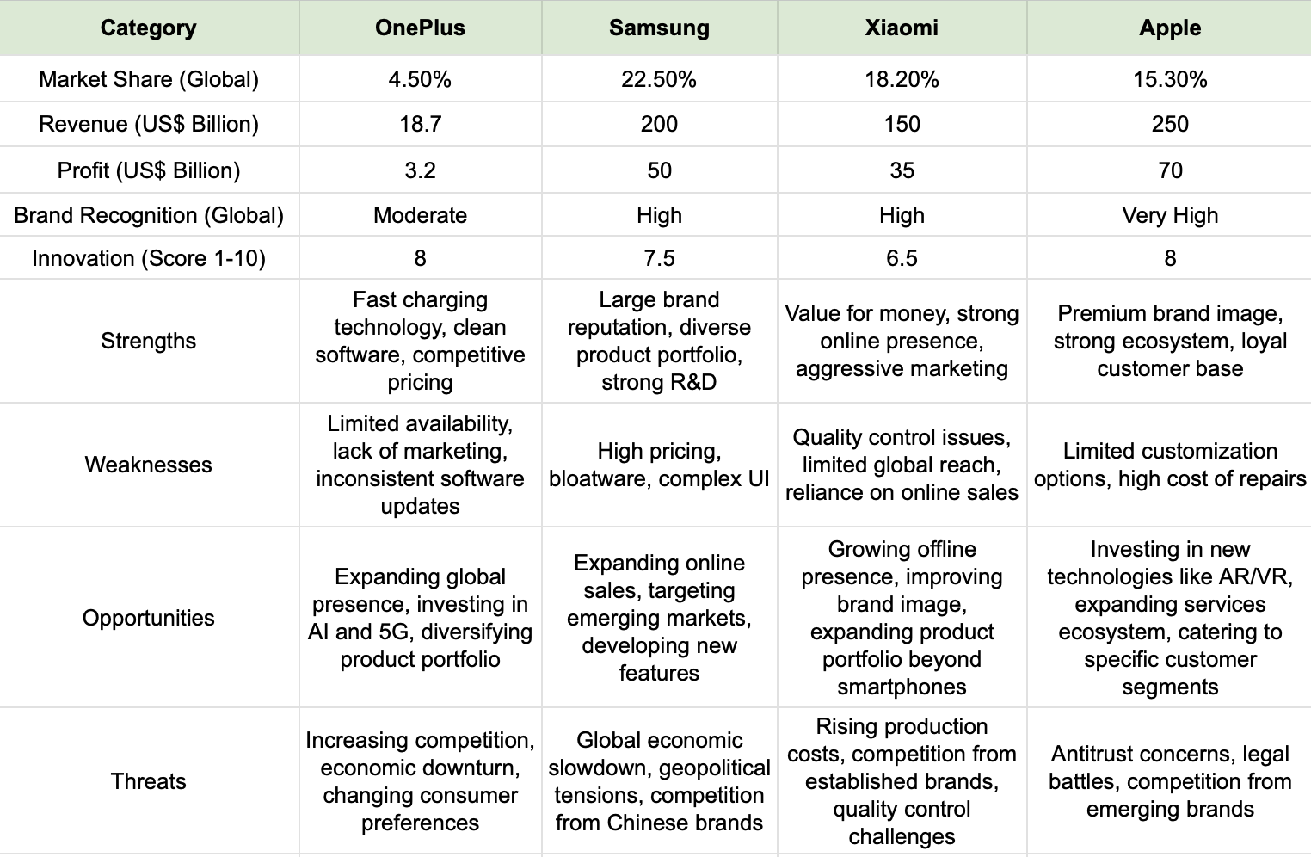
Major Competitors

Slide 6
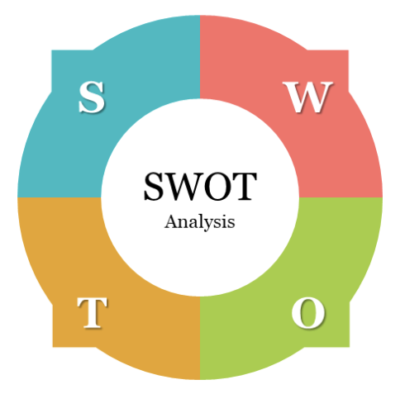
STRENGTH
Focus on High-Quality Products
Cost-Effective Devices
Strong Online Presence and Marketing
Customer-First Approach
Rapid Technological Advancements
WEAKNESS
Limited Offline Presence
Product Portfolio
Brand Perception
Market Dependence
Post-Sales Service
THREAT
Intense Competition
Dependence on Android
Rising Production Costs
Global Economic and Political Factors
Brand Perception
OPPORTUNITIES
Expand Offline Presence
Diversify Product Portfolio
Extend Services
Market Expansion
Partnerships and Collaborations

Slide 7
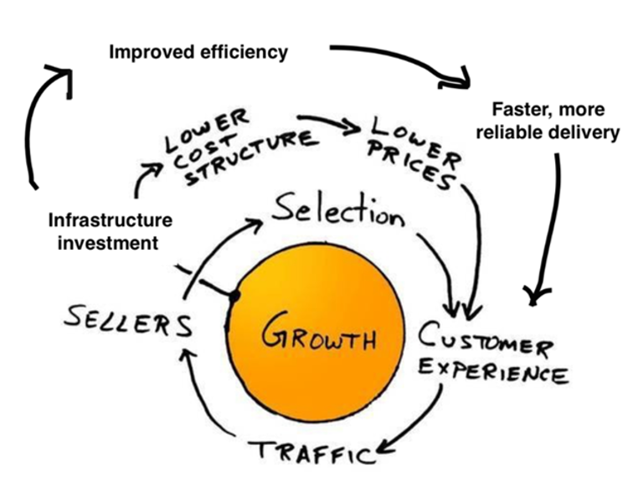
Strategy in context of Flywheel Framework
Customer Experience: VIP Customer Program User-Centric Design | Traffic: Referral Programs Influencer Partnerships
Sellers: Partnerships with Carriers and Retailers Co-branding Opportunities | Selection: Diversify Product Line Limited Edition Releases
Lower Prices: Economies of Scale Dynamic Pricing Models | Improved Efficiency: Invest in Logistics Streamline Operations
Infrastructure Investment: R&D Investment Customer Service Expansion | Growth: Market Expansion Brand Advocacy

Slide 8
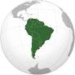
Our Pivotal Strategy
WHY?
Emerging Markets with Growth Potential: growing middle classes, and a demand for quality goods and services.
Mercosur Countries: Brazil, Argentina, Uruguay, and Paraguay - Combined population of 260 million and a GDP exceeding $3 trillion
CPTPP (Comprehensive and Progressive Trans-Pacific Partnership)Member Countries: Mexico, Chile, and Peru.
Regional Economic Growth: Latin America's GDP growth, expected to grow by 2.6 percent, particularly in Mexico, Brazil, Colombia, and Argentina,
Business-Friendly Environment: offer incentives to foreign businesses, such as lower taxes and investment incentives
Improved Infrastructure
Local Talent Pool
Expansion to South America

Slide 9












How?
1. Market Analysis: Assessing consumer preferences, market trends, and competitors in South America.
2. Product Localization: Adapting products to meet local consumer needs and preferences.
3. Legal Compliance: Ensuring adherence to South American legal and regulatory requirements.
4. Partnership Development: Forming strategic alliances with local distributors and retailers.
5. Pricing & Financial Planning: Setting competitive prices and planning financial operations.
6. Supply Chain & Logistics: Establishing a network for efficient product distribution and logistics.
7. Marketing & Brand Building: Implementing campaigns to build brand awareness and market presence.
8. Sales Strategy: Developing and executing strategies to drive product sales.
9. Customer Support:: Providing excellent customer service and after-sales support.
10. Performance Monitoring: Continuously tracking and evaluating market performance.
11. CSR (Corporate Social Responsibility): Engaging in social responsibility initiatives to enhance brand image and community contribution.
12. Long-term Growth: Planning for future expansion and sustained growth in the region.
Market Analysis
Product Localization
Legal Compliance
Partnership
Development
Pricing & Financial
Planning
Supply Chain & Logistics
Marketing &
Brand Building
Marketing & Brand Building
Sales Strategy
Customer Support
Performance Monitoring
CSR
Long-Term Growth

Slide 10
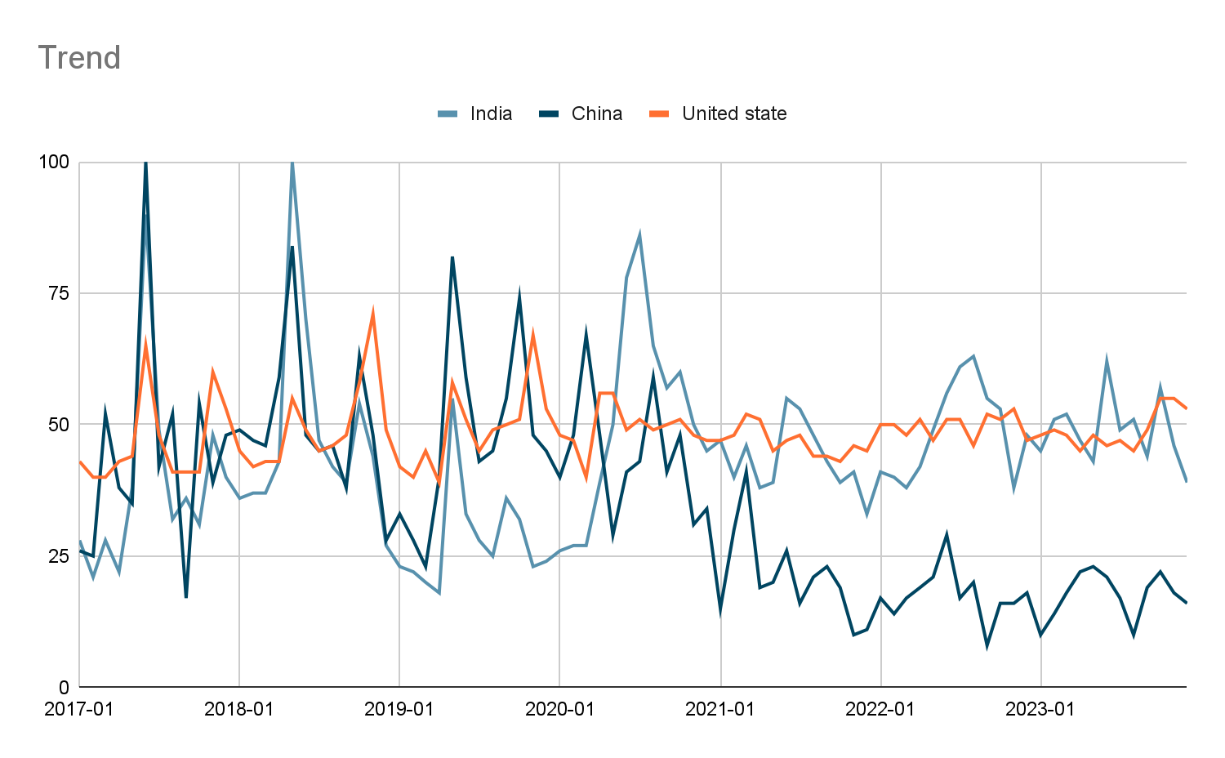
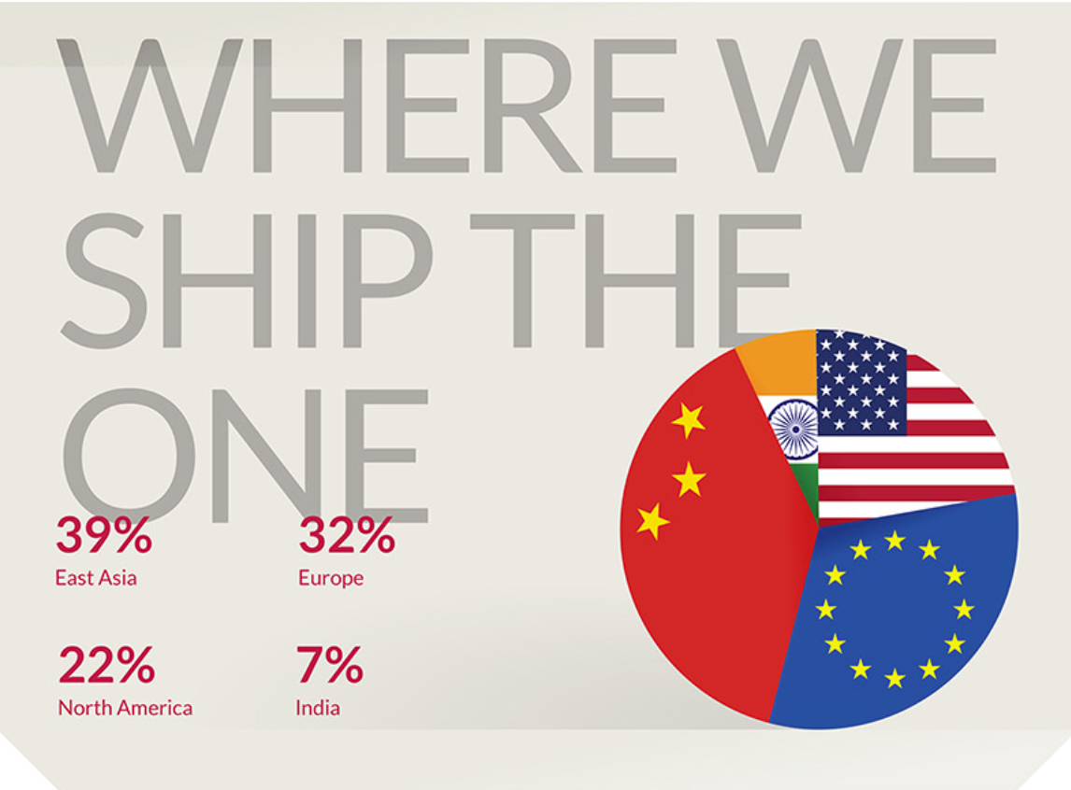







Graphs comparison

Slide 11
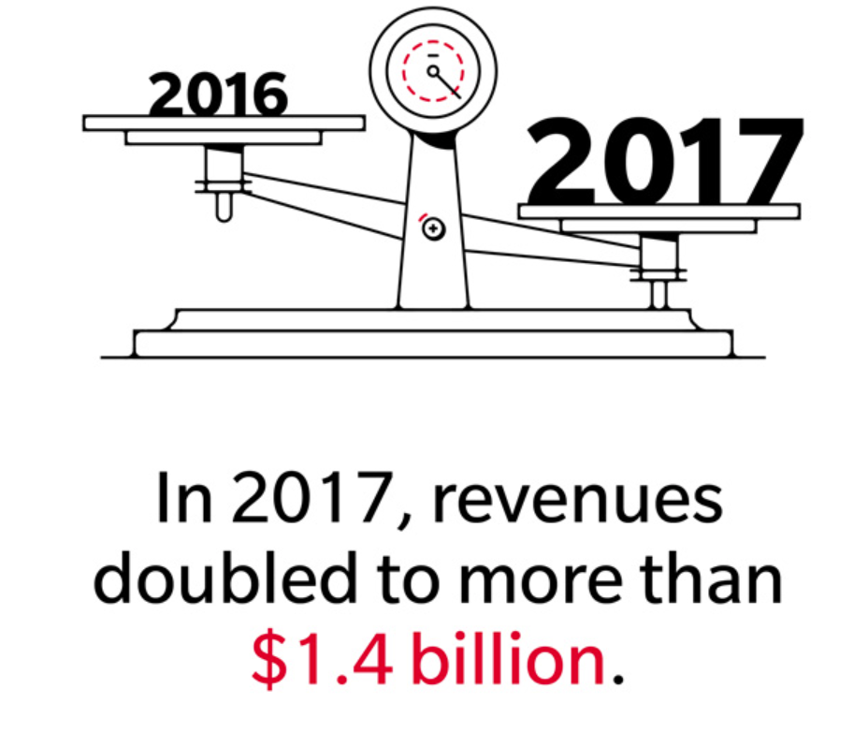
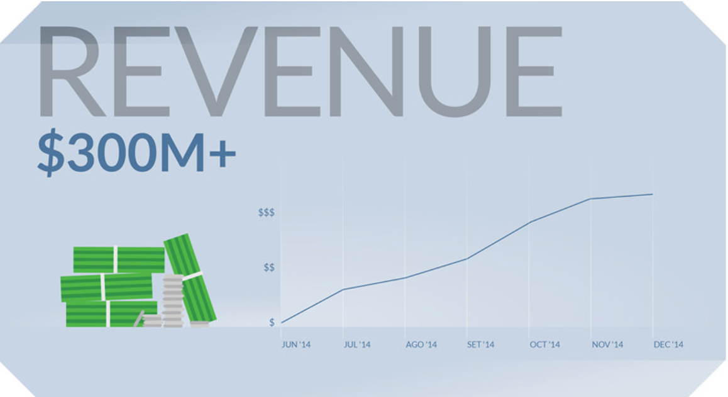
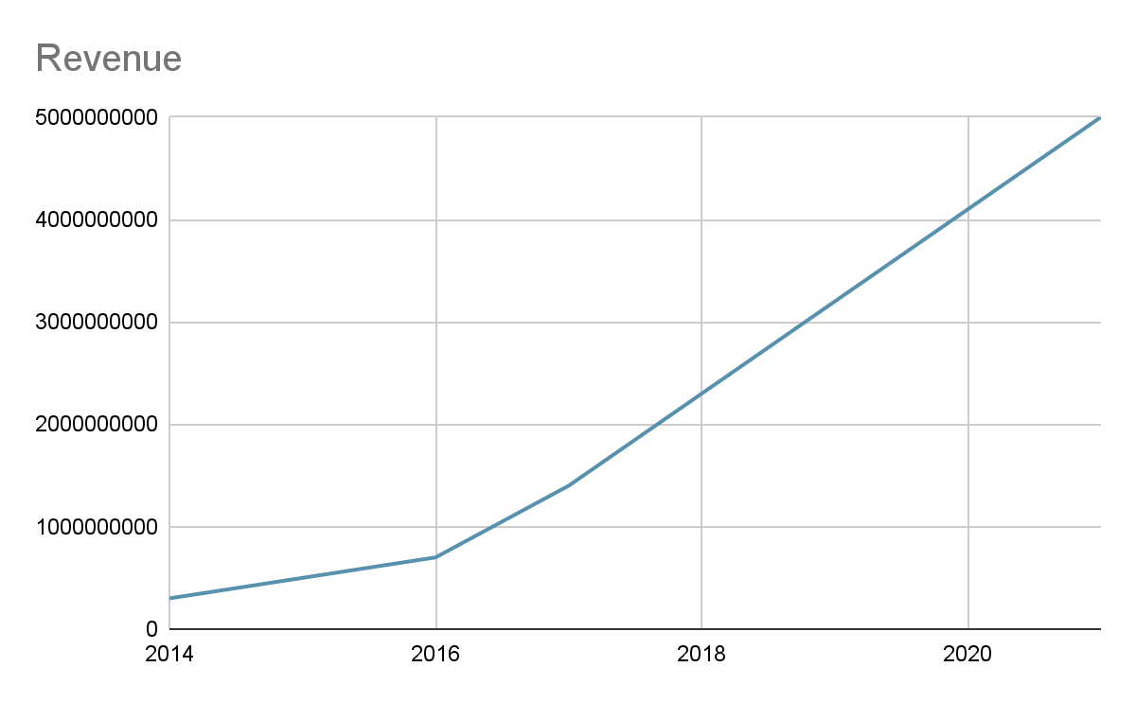
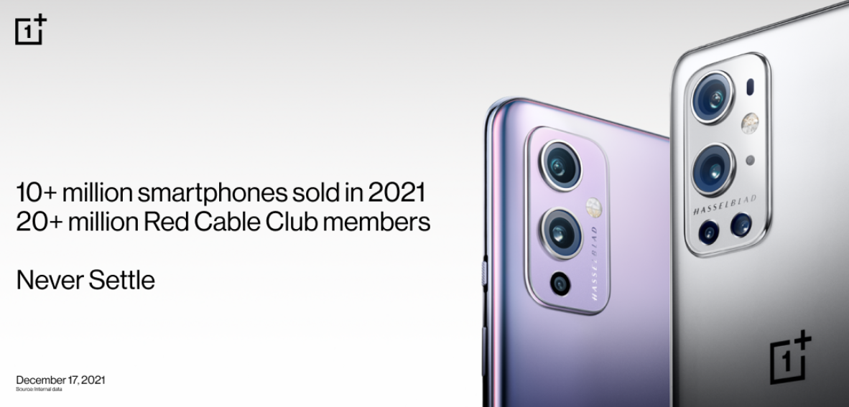
One Plus Revenue

Slide 12
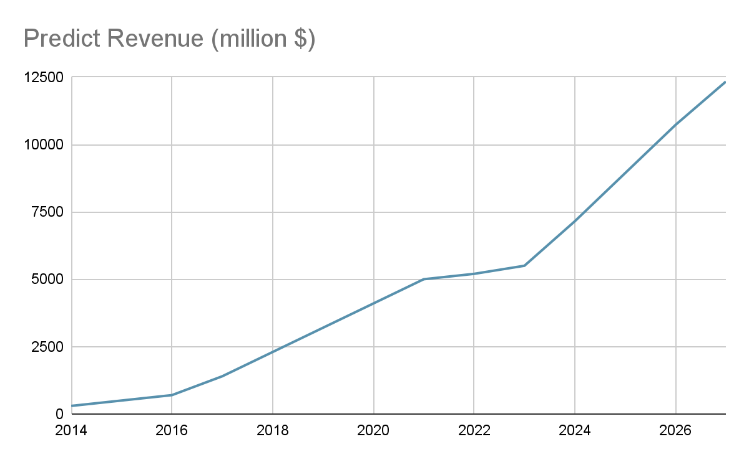
Our predictions

Slide 13
Conclusion
South America could potentially be a good market for OnePlus, especially if the company can leverage its strengths in product quality and affordability while adapting to local market conditions and consumer preferences. However, success in this region would depend on a well-planned strategy addressing the unique challenges and opportunities of the South American market.

